Slide 1

Bhilai Institute of Technology, Raipur
(MAJOR RESEARCH PROJECT PHASE-2)
Comparative Analysis of Hybrid Models of AES-RSA and AES-Triple DES Algorithms for Encryption of Images and Videos
Guided by: Mrs. Lalita Panika
Assistant Professor, CSE Department
BIT Raipur
Members: Harsh Chandrakar (309302220027)
J Kirti Rao (309302220040)
Varun Maharana (309302220094)
Simran Dey Biswas (309302220098)
8th Semester, CSE Department
BIT Raipur

Slide 2
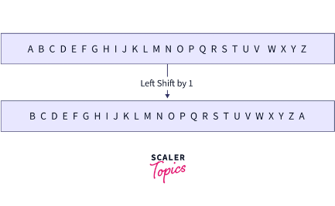

1. Introduction
Cryptography:
The art and science of concealing the messages to introduce secrecy in information security is recognized as cryptography. The process of disguising a message in such a way as to hide its substance is encryption. An encrypted message is ciphertext.
Hybrid Encryption:
Hybrid encryption is a security approach that combines the strengths of both symmetric and asymmetric encryption. In this method, a symmetric key is used for efficient data encryption, while an asymmetric key is employed for secure key exchange.

Slide 3
1. Introduction
RSA | RSA algorithm is an asymmetric cryptography algorithm which means that it works on two different keys i.e. Public Key and Private Key.
AES | AES (Advanced Encryption Standard) is a widely used technique for protecting data using encryption algorithms. AES is a symmetric block cipher, meaning the same key is used for both encrypting and decrypting data.
DES | Data Encryption Standard (DES) is a historic symmetric-key algorithm used for the encryption of digital data. DES has been highly influential in the advancement of cryptography

Slide 4
2. Review of literature
Name of the Paper | Publishing Year | Publisher | Author | Result
Image Encryption Based on AES and RSA Algorithms | 2020 | IEEE | Dalia Mubarak Alsaffar, Atheer Sultan Almutiri, Bashaier Alqahtani, Rahaf Mohammed Alamri, Hanan Fahhad Alqahtani, Nada Nasser Alqahtani, Ghadeer Mohammed alshammari, Azza. A. Ali | The results showed that the AES algorithm correlation coefficient tends to be closer to the zero, thus a stronger correlation. Also, AES algorithm has a better image encryption quality since it has a more convergent columns in the histogram.
Speed Up Image Encryption by Using RSA Algorithm | 2020 | IEEE | Faten H. Mohammed Sediq Al-Kadei, Huda Abdalkaream Mardan, Nevart A. Minas | The results indicate that the execution time of encryption process was improved by 14% in experiment 3 by using some techniques to speed up the process, the decryption process was improved as well by 22%.

Slide 5
2. Review of literature
Name of the Paper | Publishing Year | Publisher | Author | Result
Image Encryption using AES Algorithm: Study and Evaluation | 2022 | International Journal for Research in Applied Science & Engineering | Pratiksha Shete, Surekha Kohle | In addition to basic solutions for the development of a modern algorithm, the mentioned research also includes some future recommendations for designers and academic specialists. The AES algorithm certainly has some weaknesses, but they are minimal compared to its strengths.
A NEW HYBRID VIDEO ENCRYPTION TECHNIQUE BASED ON AES CRYPTOGRAPHY | 2023 | International Journal of Progressive Research in Engineering and Science | Anjali Krishna, Sarika Jain, S Geetha | The results reveal that the proposed stream cipher pleases the demand for safe and secure encryption principles. The encrypted photos or video clips are safe in perception. The encryption procedure does not transform the compression proportion, and the scheme enhances little computational expense compared with video file encryption

Slide 6
2. Review of literature
Name of the Paper | Publishing Year | Publisher | Author | Result
HYBRID RSA-AES ENCRYPTION FOR WEB SERVICES | 2015 | International Journal of Technical Research and Application | Kalyani Ganesh Kadam, Prof. Vaishali Khairnar | The proposed solution can be used for ensuring security and integrity while exchanging data between client applications and web service.
ENHANCING HYBRID SECURITY APPROACH USING AES AND RSA ALGORITHMS | 2021 | Journal of Engineering and Sustainable Development | Samir G. Chaloop, Mahmood Z. Abdullah | The results showed that the hybrid encryption is 67.47% faster than the RSA algorithm and 32.39% slower than the AES algorithm.

Slide 7
2. Review of literature
Name of the Paper | Publishing Year | Publisher | Author | Result
A Literature Review on RSA, DES and AES Encryption Algorithms | 2023 | Emerging Trends in Engineering and Management | Roopali Sood, Harpreet Kaur | According to literature survey, it has been found that AES algorithm is most efficient in terms of speed, time, throughput and avalanche effect. The security provided by these algorithms can be enhanced further, if more than one algorithm is applied to data. Future work will explore this concepts and combination of algorithms will be applied either sequentially or parallel to set up a more secure environment for data storage and retrieval.
Comparative Analysis of Encryption Algorithms | 2023 | European Journal of Technology | Agbelusi Olutola and Matthew Olumuyiwa | The results obtained from the development revealed that AES is considered more efficient because it uses lesser time for encryption and decryption, reduces cipher and key length as compared with RSA which consumes longer encryption and decryption time, and increases cipher and key length. Excel package was also used to display the pictorial representation of the comparison between these algorithms.

Slide 8
2. Review of literature
Name of the Paper | Publishing Year | Publisher | Author | Result
Comparative Analysis of Aes and Rsa Algorithms for Data Security in Cloud Computing | 2022 | MDPI | Sana Fatima, Tanazzah Rehman, Muskan Fatima, Shahmeer Khan and Mir Arshan Ali | The AES algorithm is the method of lesser time complexity and due to its flexible and scalable behaviour it is easily implemented, leaving the RSA algorithm behind in terms of memory requirements. The AES algorithm protects data with its high security level and can counterattack against a variety of attacks. Thus, a hybrid model of AES and RSA will increase the security of the cloud overall.
Comparative Analysis of Encryption Algorithms | 2018 | Covenant Journal of Informatics & Communication Technology | Nureni Ayofe Azeez & Sayyidina'Aliyy Bolaji Abubakar | The results obtained from the experimentation revealed that AES uses the lowest time for encryption while RSA consumes longest encryption time. Also, AES algorithm is considered the most efficient of all the three algorithms based on the metrics used for the evaluation.

Slide 9
3. Research Gap
In our literature survey we have found that none of the past researches have made a study on the implementation of the hybrid model of AES and Triple DES algorithm for the encryption of images and videos but only made a stand alone implementation of AES or RSA or Triple DES algorithms.
Some works also have just implemented the hybrid model of AES and RSA algorithm which is working on the encryption of plain text and some amount of media files.
There is no work done that compares the two hybrid models of AES-RSA and AES-Triple DES algorithms that work on the encryption of media files like images and videos.

Slide 10
4. Objective
The project aims to implement the hybrid algorithm models of AES with RSA and AES with Triple DES algorithm for the encryption of images and videos.
We will focus on the comparative analysis of both of these hybrid models on the basis of time complexity, space complexity, strength, use case and applicability.

Slide 11
5. Methodology
The approach or planning for the project is to create a program that implements the hybrid implementation of AES and RSA algorithms and AES and Triple DES algorithms respectively i.e. encrypts the data using both the algorithms and also decrypts in a suitable manner.
The implementation of the algorithms matters as it will decide the parameters that will make the process more or less efficient which includes time and space complexity, strength of cypher, speed of execution, size of the encrypted media, effectiveness, and their applicability in different scenarios.
Implementing the AES and RSA algorithms and AES and Triple DES algorithms respectively and then making a comparative analysis of their performance while they encrypt and decrypt multimedia files such as images and videos.

Slide 12
Encryption:
Convert the Image/Video to a Byte Array: Read the image or video file and convert it into a byte array. This array will represent the raw data of the file.
Segmentation (Optional): If the file size exceeds the RSA key length (e.g., 2048 bits), segment the byte array into smaller blocks that fit within the key length.
Encryption: For each segment, perform RSA encryption using the public key. This results in encrypted segments.
Output: Save the encrypted segments as a file or transmit them securely over a network.

Slide 13
Decryption:
Decryption: For each encrypted segment, perform RSA decryption using the private key to obtain the original byte array segments.
Reassembly (Optional): If the file was segmented during encryption, reassemble the byte array segments into a single byte array.
Conversion to Image/Video: Convert the byte array back to its original image or video format.
Output: Save the decrypted image or video file

Slide 14
Implementing AES and RSA in a hybrid manner
AES and RSA algorithms together for encrypting and decrypting image and video files involves using AES for symmetric encryption of the actual file data and RSA for asymmetric encryption of the symmetric key used by AES
Encryption:
Generate Keys
Encrypting the Image/Video File with AES
Encrypting the AES Key with RSA
Output
Decryption:
Retrieve Files
Decrypting the AES Key with RSA
Decrypting the Image/Video File with AES
Output

Slide 15
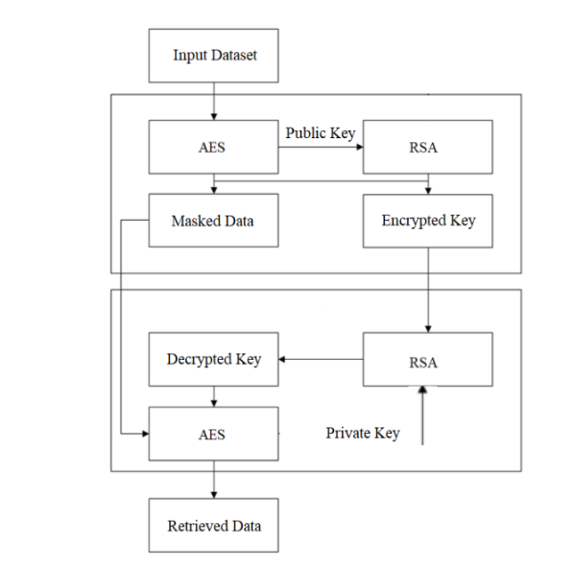
HYBRID Implementation - Flowchart
Fig. 5.1: Hybrid implementation of AES & RSA

Slide 16
AES and RSA Hybrid for the Encryption of Images
Lines of Code (LOC) | 58 lines
Time Complexity
Key Pair Generation (RSA) | O(n^2) or O(n^3)
AES Key Generation | O(1)
Image Encryption (AES) | O(m)
AES Key Encryption (RSA) | O(k^3)
AES Key Decryption (RSA) | O(k^3)
Image Decryption (AES) | O(m)
Space Complexity
Key Pair Generation (RSA) | O(1)
AES Key Generation | O(1)
Image Encryption (AES) | O(m)
AES Key Encryption (RSA) | O(k)
AES Key Decryption (RSA) | O(k)
Image Decryption (AES) | O(m)
Image | .png | 520 KB

Slide 17
AES and RSA Hybrid for the Encryption of Images
Overall, time and space complexity.
Time Complexity | O(m + k^3 + n^3)
Space Complexity | O(m + k + n)
Here, n represents the key size in RSA (2048 bits), m represents the size of the image, and k represents the key size in AES (128 bits).

Slide 18
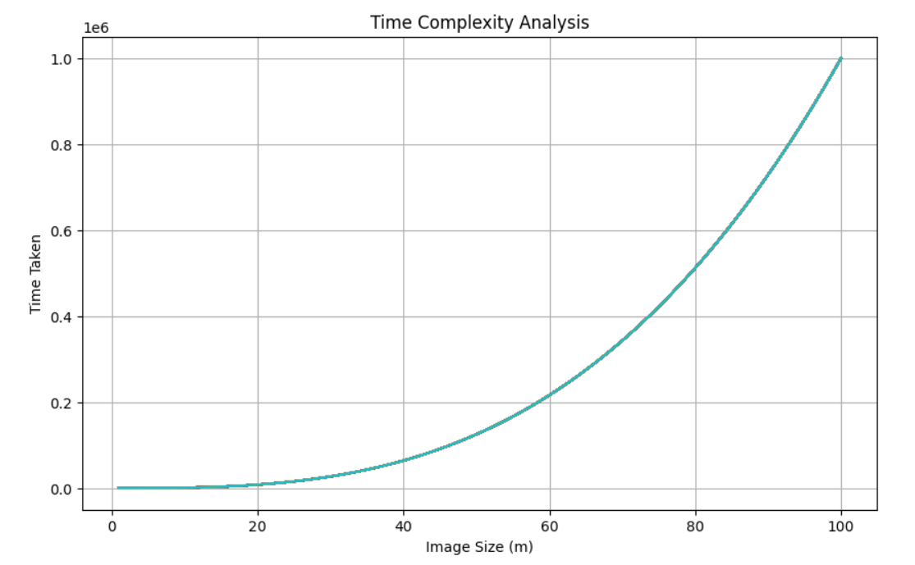
AES and RSA Hybrid for the Encryption of Images
Fig. 5.1: Time Complexity Graph of AES and RSA for Images

Slide 19
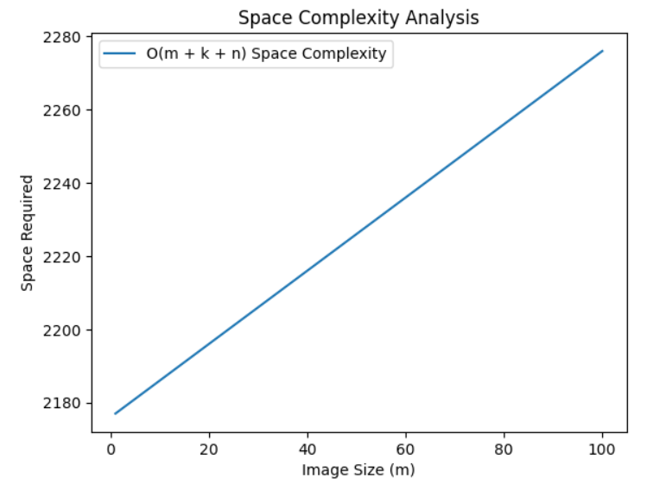
AES and RSA Hybrid for the Encryption of Images
Fig. 5.1: Space Complexity Graph of AES and RSA for Images

Slide 20
AES and RSA Hybrid for the Encryption of Images
Strength Analysis:
RSA Encryption: The code employs RSA with a key size of 2048 bits, which is considered secure for the foreseeable future against classical and quantum attacks.
AES Encryption: AES with a 128-bit key is used for encrypting image data. While AES with a 128-bit key is still widely used and considered secure, using a larger key size like 256 bits might provide an extra layer of security against future advancements in cryptanalysis.
Hybrid Encryption: The code utilizes a hybrid encryption scheme combining RSA and AES. This approach leverages the strengths of both algorithms: RSA for key exchange and AES for efficient bulk encryption. It ensures confidentiality and integrity of the data while minimizing computational overhead.

Slide 21
AES and RSA Hybrid for the Encryption of Videos
Lines of Code (LOC) | 74 lines
Time Complexity
Key Pair Generation (RSA) | O(n^3)
AES Key Generation | O(1)
Video Encryption (AES) | O(m)
AES Key Encryption (RSA) | O(k^3)
AES Key Decryption (RSA) | O(k^3)
Video Decryption (AES) | O(m)
Space Complexity
Key Pair Generation (RSA) | O(1)
AES Key Generation | O(1)
Video Encryption (AES) | O(m)
AES Key Encryption (RSA) | O(k)
AES Key Decryption (RSA) | O(k)
Video Decryption (AES) | O(m)
Video | .mp4 | 2642 KB | 10 Sec

Slide 22
AES and RSA Hybrid for the Encryption of Videos
Overall, time and space complexity.
Time Complexity | O(n^3 + m + k^3)
Space Complexity | O(m + k + n)
Here, n represents the RSA key size (2048 bits), m represents the size of the video file, and k represents the AES key size (256 bits).

Slide 23
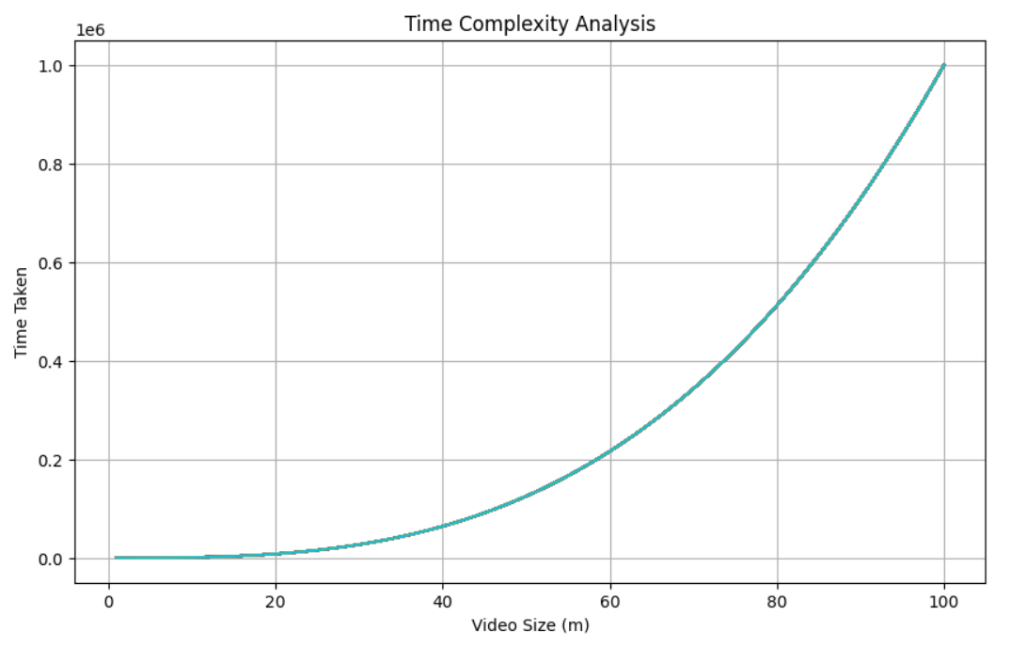
AES and RSA Hybrid for the Encryption of Videos
Fig. 5.1: Time Complexity Graph of AES and RSA for Videos

Slide 24
AES and RSA Hybrid for the Encryption of Videos
Strength Analysis:
RSA Key Size: The RSA key size is set to 2048 bits, which is considered strong enough for most applications as of the last update in 2022.
AES Key Size: The AES key size is set to 256 bits, providing strong encryption.
Padding Scheme: PKCS1Padding is used for RSA encryption and decryption, which is a standard padding scheme.
Mode of Operation: ECB mode is used for both RSA and AES encryption, which has certain vulnerabilities. It's recommended to use more secure modes like CBC or GCM.
Overall, the code seems to implement hybrid encryption using strong cryptographic primitives. However, using more secure modes of operation for encryption could further enhance its security.

Slide 25
Merits of AES with RSA in Hybrid encryption
Security: By combining AES with RSA, you get the benefits of both symmetric and asymmetric encryption, providing a high level of security for data transmission.
Efficiency: By using RSA to encrypt a randomly generated AES key instead of the entire message, the computational overhead is significantly reduced, resulting in a more efficient encryption process.
Key Management: In a hybrid encryption scheme using AES with RSA, the AES key is securely exchanged using RSA encryption, providing a more manageable and secure key management solution.
Forward Secrecy: In a hybrid encryption scheme, if ephemeral AES keys are used for each session and exchanged using RSA encryption, forward secrecy can be achieved. Even if the RSA private key is compromised in the future, previously encrypted messages remain secure because they were encrypted with different AES keys.
Adaptability: Hybrid encryption allows for flexibility in choosing encryption algorithms based on specific security requirements and constraints. By combining AES with RSA, you can tailor the encryption process to suit different scenarios, such as balancing security, efficiency, and key management considerations.

Slide 26
Demerits of AES with RSA in Hybrid encryption
Increased Complexity: Implementing hybrid encryption with both AES and RSA adds complexity to the encryption and decryption processes.
Performance Overhead: While AES is efficient for encrypting large amounts of data due to its symmetric nature, RSA is computationally more expensive, especially for key generation and encryption of large data sets.
Key Length mismatch: The key length mismatch can introduce complexities in key management and may require additional padding or adjustments to ensure compatibility between the two encryption schemes.
Key Distribution: While RSA can facilitate secure key exchange through its asymmetric encryption mechanism, managing RSA key pairs securely and distributing public keys to all communicating parties can be challenging.
Potential Security Vulnerabilities: Hybrid encryption introduces additional attack vectors compared to using a single encryption scheme. Ensuring the secure implementation of both AES and RSA, as well as proper key management practices, is crucial to mitigating these risks.

Slide 27
Implementing AES and Triple DES in a hybrid manner
The process for encrypting and decrypting image and video files using a combination of AES for symmetric encryption and Triple DES (3DES) for asymmetric encryption of the symmetric key can be outlined as follows:
Encryption:
Generate Keys
Encrypting the Image/Video File with AES
Encrypting the AES Key with 3DES
Output
Decryption:
Retrieve Files
Decrypting the AES Key with 3DES
Decrypting the Image/Video File with AES
Output

Slide 28
AES - Triple DES Encryption Flowchart
Input - Image/Video
Key Generation for AES
{securely generated keys}
Key Generation for DES
Image/Video Chunking
{smaller parts}
AES Encryption using AES key
{AES algorithm}
Output AES Chunk
Fig. 5.2: Hybrid implementation of AES & Triple DES
Triple DES Encryption using DES key
{Triple DES algorithm}
Output - Encrypted Image/Video
{output Triple DES chunks}

Slide 29
AES and Triple DES Hybrid for the Encryption of Images
Lines of Code (LOC) | 74 lines
Time Complexity
Key Pair Generation (TDES) | O(1)
AES Key Generation | O(1)
Image Encryption (AES) | O(m)
Image Decryption (AES) | O(m)
Space Complexity
Key Pair Generation (TDES) | O(1)
AES Key Generation | O(1)
Image Encryption (AES) | O(m)
Image Decryption (AES) | O(m)
Image | .png | 520 KB

Slide 30
AES and Triple DES Hybrid for the Encryption of Images
Overall, time and space complexity.
Time Complexity | O(m + k^3 + n^3)
Space Complexity | O(m + k + n)
Where m represents the size of the image.

Slide 31
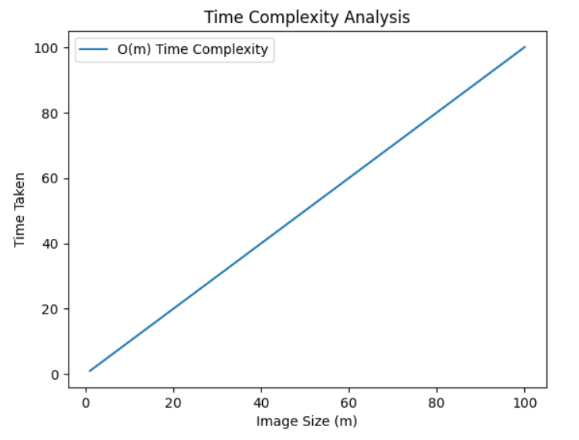
AES and Triple DES Hybrid for the Encryption of Images
Fig. 5.1: Time Complexity Graph of AES and Triple DES for Images

Slide 32
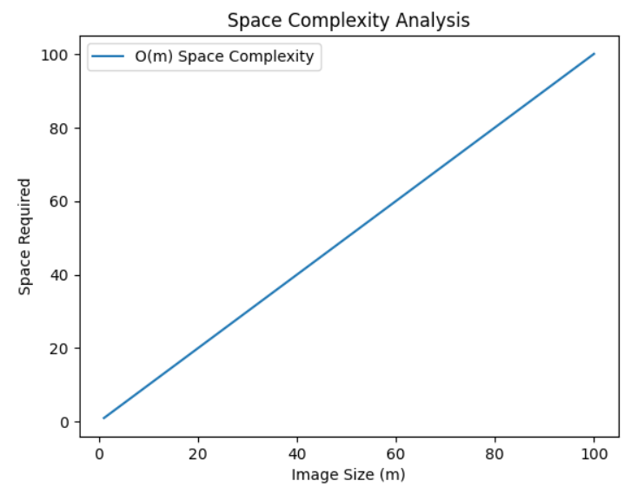
AES and Triple DES Hybrid for the Encryption of Images
Fig. 5.1: Space Complexity Graph of AES and Triple DES for Images

Slide 33
AES and Triple DES Hybrid for the Encryption of Images
Strength Analysis:
AES: AES with a 256-bit key is considered very secure and is widely used in practice.
Triple DES: While Triple DES (3DES) was once considered secure, its 168-bit key length is now considered insufficient for modern security requirements. It's generally recommended to use AES instead of Triple DES for new applications.
Overall, AES provides stronger security compared to Triple DES due to its longer key length. Therefore, in terms of strength, using AES is preferred over Triple DES.

Slide 34
AES and Triple DES Hybrid for the Encryption of Videos
Lines of Code (LOC) | 58 lines
Time Complexity
Key Pair Generation (TDES) | O(1)
AES Key Generation | O(1)
Video Encryption (AES) | O(m)
Video Decryption (AES) | O(m)
Space Complexity
Key Pair Generation (TDES) | O(1)
AES Key Generation | O(1)
Video Encryption (AES) | O(m)
Video Decryption (AES) | O(m)
Video | .mp4 | 2642 KB | 10 Sec

Slide 35
AES and Triple DES Hybrid for the Encryption of Videos
Overall, time and space complexity.
Time Complexity | O(m)
Space Complexity | O(m)
Where m represents the size of the image.

Slide 36
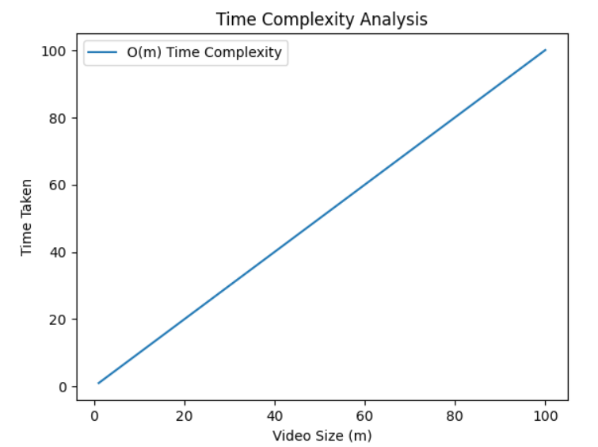
AES and Triple DES Hybrid for the Encryption of Videos
Fig. 5.1: Time Complexity Graph of AES and Triple DES for Videos

Slide 37
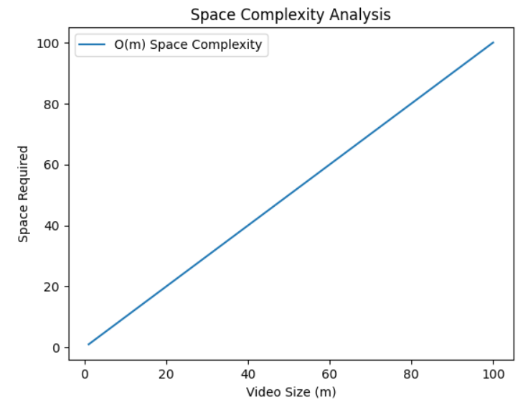
AES and Triple DES Hybrid for the Encryption of Videos
Fig. 5.1: Space Complexity Graph of AES and Triple DES for Videos

Slide 38
AES and Triple DES Hybrid for the Encryption of Videos
Strength Analysis:
AES with a 256-bit key size is considered very secure and is widely recommended.
Triple DES with a 168-bit key size was once considered secure, but it is now considered insufficient for modern security requirements. It's generally recommended to use at least 192 bits or preferably 256 bits for Triple DES to achieve comparable security to AES.
Therefore, in terms of strength, using AES with a 256-bit key size is preferred over Triple DES with a 168-bit key size.

Slide 39
Merits of AES with Triple DES in Hybrid encryption
Security: By combining the two algorithms, you create a layered security approach, potentially enhancing overall security.
Compatibility: By incorporating 3DES into a hybrid encryption scheme alongside AES, you can ensure compatibility with legacy systems or environments where 3DES is already deployed.
Key Length Flexibility: By using AES with 3DES in hybrid encryption, you can benefit from the flexibility of AES key lengths while still leveraging 3DES in environments where it may be required or preferred.
Performance: While AES is more computationally efficient than 3DES, there may be situations where the performance overhead of 3DES is acceptable or necessary, particularly in environments where AES hardware acceleration is not available.
Resilience to Algorithmic Weakness:: Combining AES with 3DES in hybrid encryption can mitigate the risk associated with potential weaknesses or vulnerabilities in either algorithm.
Interoperability: Hybrid encryption schemes that incorporate both AES and 3DES can offer interoperability benefits, allowing systems with different encryption capabilities or requirements to communicate securely.

Slide 40
Demerits of AES with triple DES in Hybrid encryption
Reduced Security: By incorporating 3DES into a hybrid encryption scheme alongside AES, you may introduce a potential weak link in the security chain, particularly if 3DES is used extensively or in critical security contexts.
Performance Overhead: 3DES is significantly slower than AES in terms of encryption and decryption speed. Incorporating 3DES into a hybrid encryption scheme alongside AES can introduce performance overhead, particularly when encrypting or decrypting large volumes of data.
Key Length Limitation: This limitation in key length may impact the overall security of the hybrid encryption scheme, especially if longer keys are required to meet specific security requirements or mitigate potential vulnerabilities.
Dependence on Legacy Systems: Depending heavily on 3DES in a hybrid encryption scheme may limit opportunities to adopt more modern and secure encryption standards and technologies.
Potential for Interoperability Issues: Hybrid encryption schemes that combine AES with 3DES may encounter interoperability issues when communicating with systems or devices that do not support one or both of the encryption algorithms.

Slide 41
6. Conclusion
In conclusion, the hybrid algorithm models of AES with RSA and AES with Triple DES algorithm for the encryption of images and videos have been implemented. Thus, focuses on the comparative analysis of both of these hybrid models on the basis of time complexity, space complexity, strength, use case and applicability.
 | AES+RSA (Images) | AES+RSA (Videos) | AES+TDES (Images) | AES+TDES (Videos)
Time Complexity | O(m + k^3 + n^3) | O(n^3 + m + k^3) | O(m) | O(m)
Space Complexity | O(m + k + n) | O(m + k + n) | O(m) | O(m)
Table. 5.1.1: Overall comparison of complexities of Hybrid Algorithms

Slide 42
6. Conclusion
In our project, we conducted a comprehensive study of hybrid encryption models, analyzing their complexities and performance characteristics. After a thorough comparative analysis, we conclude that the hybrid encryption model combining AES (Advanced Encryption Standard) and TDES (Triple Data Encryption Standard) offers superior advantages over other hybrid models, including AES and RSA combination.
Overall, based on our comparative analysis of complexities and practical considerations, we recommend the adoption of AES+TDES as the preferred hybrid encryption model for applications where efficiency, simplicity, and performance are paramount.

Slide 43
7. Future Scope
Performance Optimization: Improve efficiency through parallel processing and algorithmic enhancements.
Security Analysis: Conduct deeper analysis to identify vulnerabilities and develop robust security measures.
Integration with Emerging Tech: Explore hybrid encryption integration with blockchain, IoT, and cloud computing.
Scalability and Flexibility: Enhance scalability and adaptability with dynamic encryption strategies.
Cross-Platform Compatibility: Ensure seamless interoperability across different platforms and systems.
User-Friendly Interfaces: Design intuitive interfaces for encryption management and monitoring.
Real-World Applications: Explore practical deployment scenarios across industries.
Quantum-Safe Encryption: Investigate quantum-safe encryption to future-proof against quantum attacks.

Slide 44
References
[1] Sood, R., & Kaur, H. (2023). A literature review on rsa, des and aes encryption algorithms. Emerging Trends in Engineering and Management, 57-63.
[2] Olutola, A., & Olumuyiwa, M. (2023). Comparative Analysis of Encryption Algorithms. European Journal of Technology, 7(1), 1-9.
[3] Fatima, S., Rehman, T., Fatima, M., Khan, S., & Ali, M. A. (2022). Comparative Analysis of Aes and Rsa Algorithms for Data Security in Cloud Computing. Engineering Proceedings, 20(1), 14.
[4] Azeez, N. A. (2018). Comparative analysis of encryption algorithms. Covenant Journal of Informatics and Communication Technology.
[5] Khan, I. Z., & Aijaz, A. (2022). A novel image encryption using AES algorithm. International Research Journal of Modernization in Engineering Technology and Science, 4(8)
[6] Kumar, C. S., & Sarala, V. (2021, July). Image encryption and decryption using AES algorithm. International Journal of Emerging Technologies and Innovative Research, 8(7), 506-518.
[7] Chowdhary, C. L., Patel, P. V., Kathrotia, K. J., Attique, M., Perumal, K., & Ijaz, M. F. (2020). Analytical study of hybrid techniques for image encryption and decryption. Sensors, 20(18), 5162.
[8] Bhandari, S. R., & Mundargi, Z. B. K. (2018, April). A review on image encryption and decryption. International Journal of Creative Research Thoughts (IJCRT), 6(2), 1314.
[9] Deshmukh, P. (2016). An image encryption and decryption using AES algorithm. International Journal of Scientific & Engineering Research, 7(2), 210-213.
[10] Padate, R., & Patel, A. (2015). Image encryption and decryption using AES algorithm. International Journal of Electronics and Communication Engineering & Technology, 23-29.

Slide 45
References
[11] Fouzar, Y., Lakhssassi, A., & Ramakrishna, M. (2023). A Novel Hybrid Multikey Cryptography Technique for Video Communication. IEEE Access, 11, 15693-15700.
[12] Poduval, A., Rai, N., Khan, P., Sane, A., & Chaudhari, T. (2021). A SURVEY ON DIFFERENT ENCRYPTION TECHNIQUES FOR IMAGE, VIDEO, AUDIO AND DOCS. International Journal of Engineering Applied Sciences and Technology.
[13] Hosny, K. M., Zaki, M. A., Lashin, N. A., & Hamza, H. M. (2023). Fast colored video encryption using block scrambling and multi-key generation. The Visual Computer, 39(12), 6041-6072.
[14] Kadam, K. S., & Deshmukh, A. (2016). Video frame encryption algorithm using AES. International Journal of Engineering Research, 5(6), 588-591.
[15] Kulkarni, A., Kulkarni, S., Haridas, K., & More, A. (2013). Proposed video encryption algorithm v/s other existing algorithms: A comparative study. arXiv preprint arXiv:1303.3485..
[16] Karthigaikumar, P., & Rasheed, S. (2011). Simulation of image encryption using AES algorithm. IJCA special issue on “computational science-new dimensions & perspectives” NCCSE, 166-172.
[17] Abomhara, M., Zakaria, O., & Khalifa, O. O. (2010). An overview of video encryption techniques. International Journal of Computer Theory and Engineering, 2(1), 1793-8201.
[18] Hosny, K. M., Zaki, M. A., Lashin, N. A., & Hamza, H. M. (2023). Fast colored video encryption using block scrambling and multi-key generation. The Visual Computer, 39(12), 6041-6072.

Slide 46
THANKYOU!

